Slide 1

Job Portal Website Project Presentation Date: 20/05/2023
Major Project (IMW651)
Degree : BCA(MAWT)
Project Guide:
Mr. Sanjeev Soni
(Sr. IT Faculty, CCSIT, Inurture)
Purushartha Singh Thakur(TCA2055005)
FACULTY OF ENGINEERING & COMPUTING SCIENCES
TEERTHANKER MAHAVEER UNIVERSITY, MORADABAD

Slide 2

Team Details
Student Name | Role
Purushartha Singh Thakur | Designing, Research, Development
Tushar Kumar | Testing
2

Slide 3
Table of Contents
Contents:
Project Brief
Methodologies, Technologies or Tools Used
Context Diagram
Entity Relationship Diagram
Data Flow Diagram
Advantages
Outcome
3

Slide 4
Project Brief
The aim of the project is to build job portal where anyone looking to get employed can visit and apply for any Job openings available in any field. For recruiters, they can post any job opening notices on the portal where potential candidates can find and apply for the opening.
Functions:
Login/Signup with verification.
Posting job opening notices/ads.
Set preferences for job search.
Blog, Tips/Tricks section for candidates.
4

Slide 5
Methodologies/ Technologies/ Tools to be used
Front End:
HTML, CSS
Material UI/Tailwind CSS
React
Back End:
NodeJS
Express
Database:
MongoDB
Tools:
VS Code
5

Slide 6
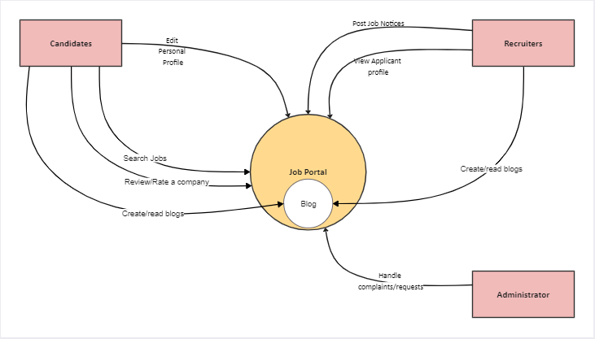
Context Diagram (Overall Project)
6

Slide 7
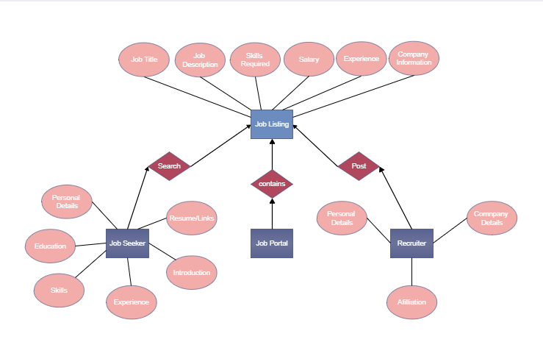
Entity Relationship Diagram (ERD)
7

Slide 8
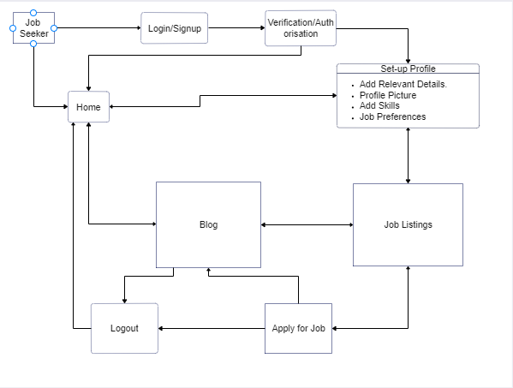
Data Flow Diagram (DFD)-Candidate
8

Slide 9
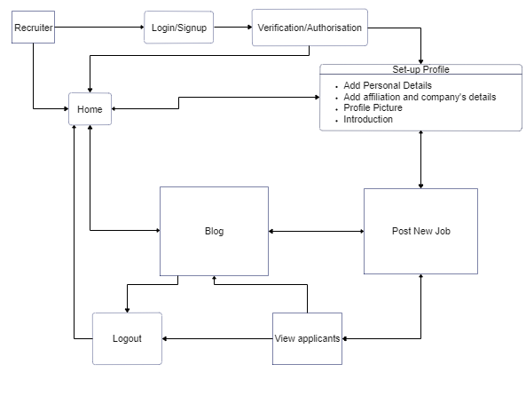
Data Flow Diagram (DFD) -Employer
9

Slide 10
\
Advantage of The Project
Strong Points of Job Portal Website:
Candidates can view their past applications
Through the Profile section, candidates can gain insight on where to improve in order to increase their chances for employment.
Job recommendation based on the skillset of the candidate.
Recruiters can view the profiles of candidates.
Profile Preview feature available to all.
10

Slide 11
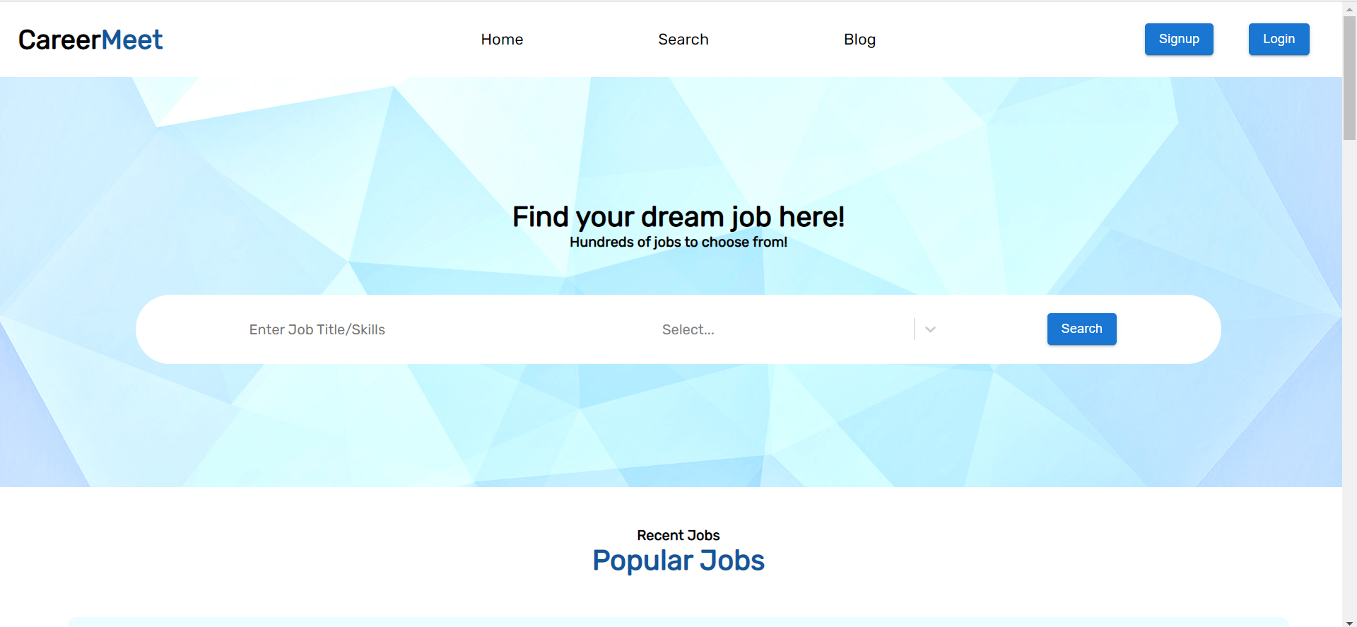
Project Outcome
Home

Slide 12
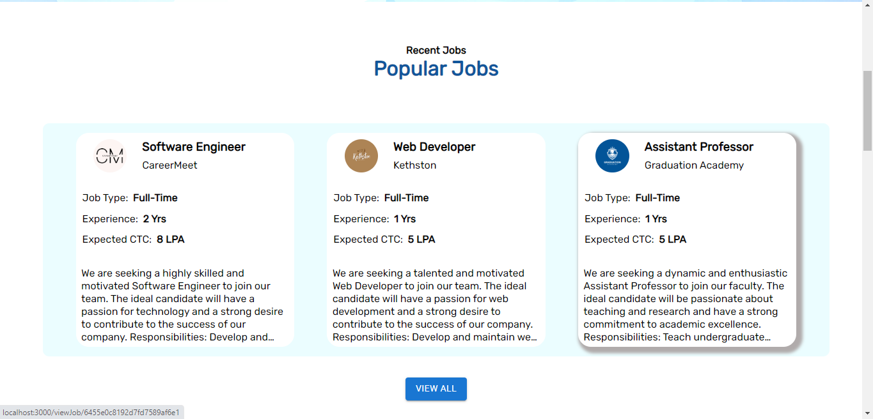

Slide 13
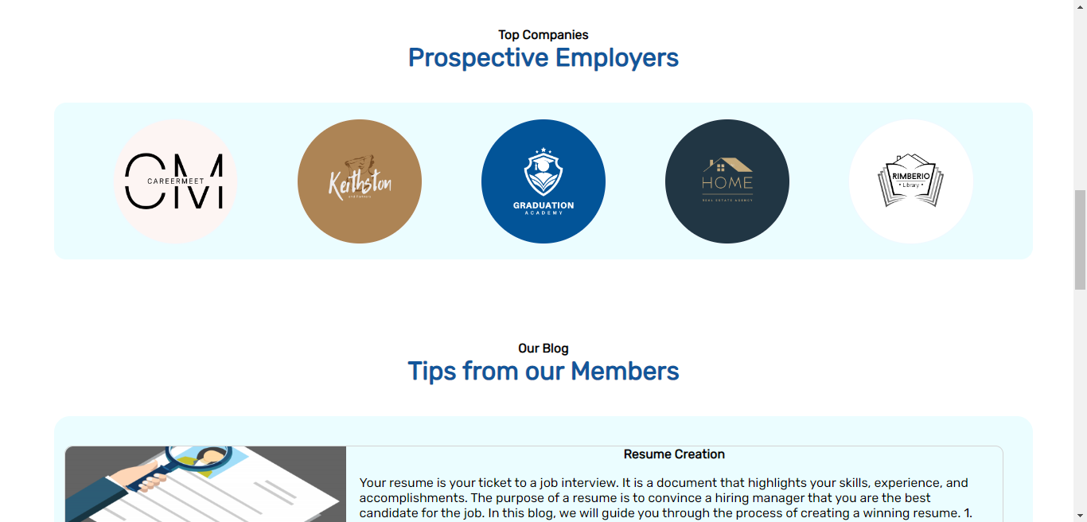

Slide 14
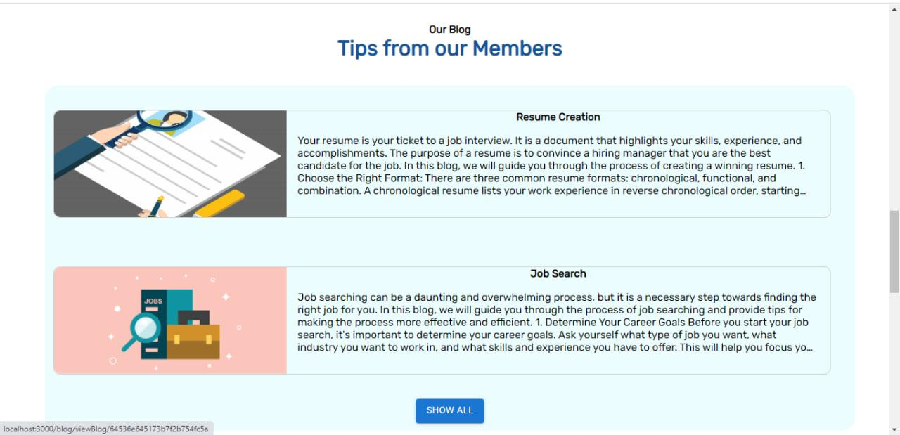

Slide 15
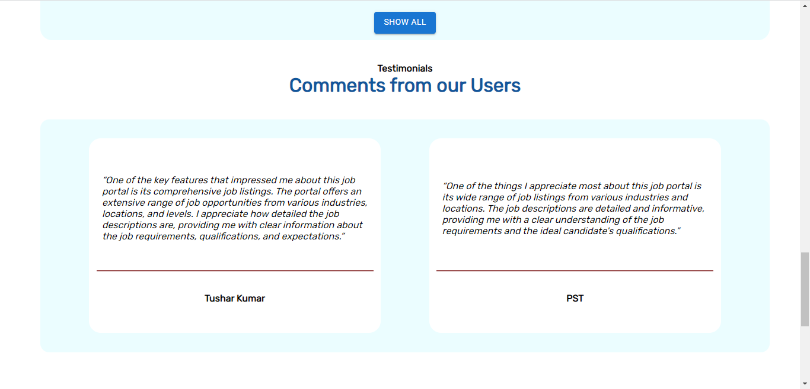

Slide 16
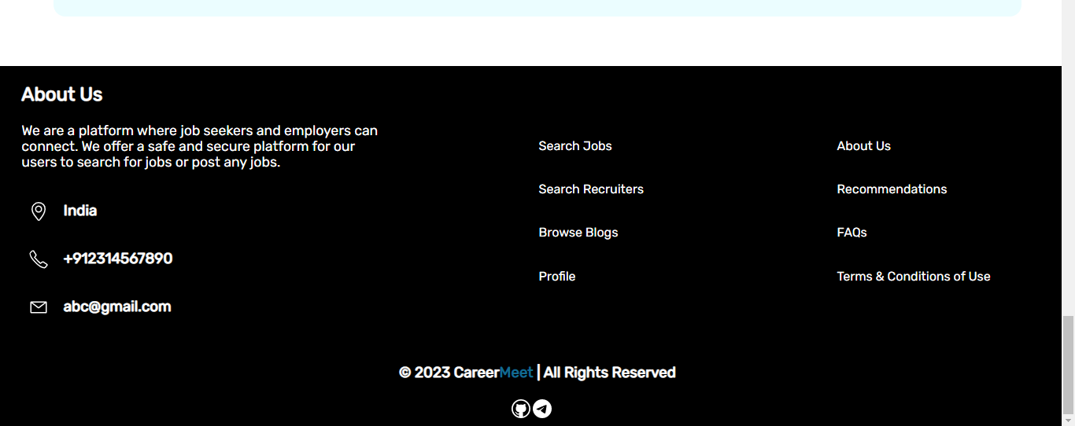
Footer

Slide 17
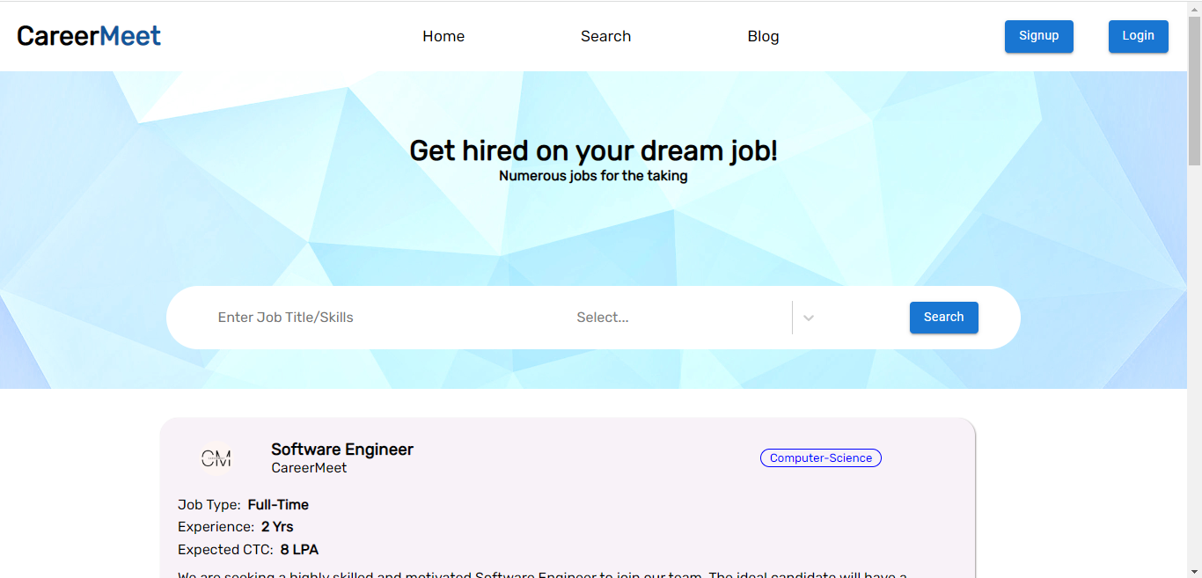
Search

Slide 18
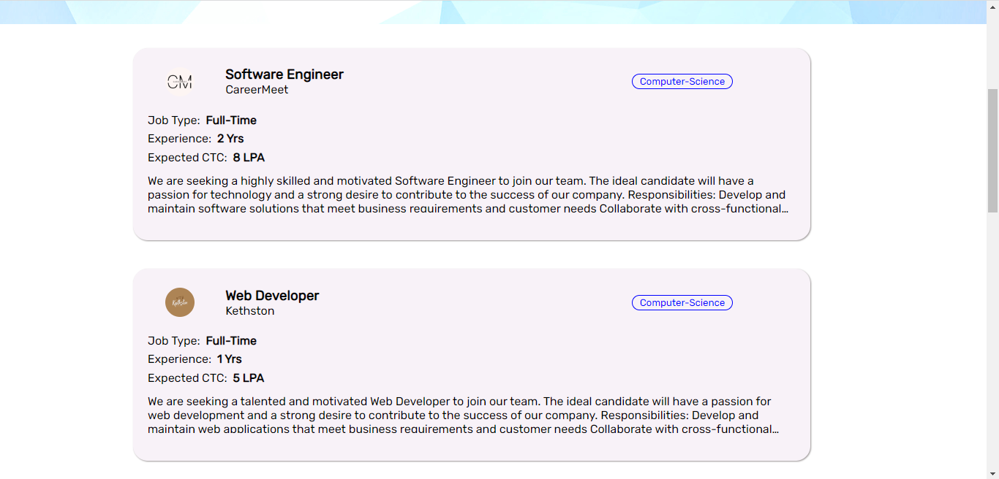

Slide 19
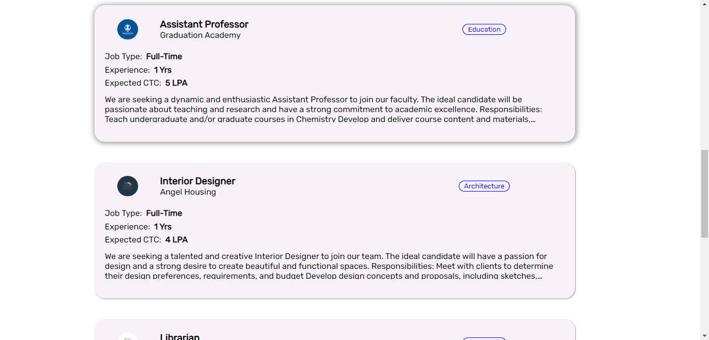

Slide 20
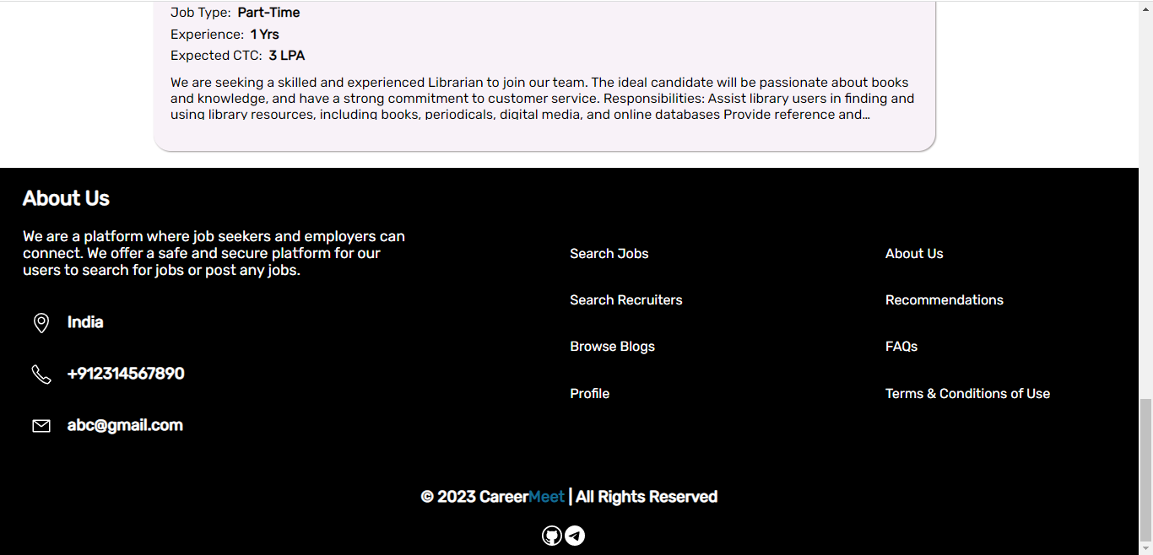

Slide 21
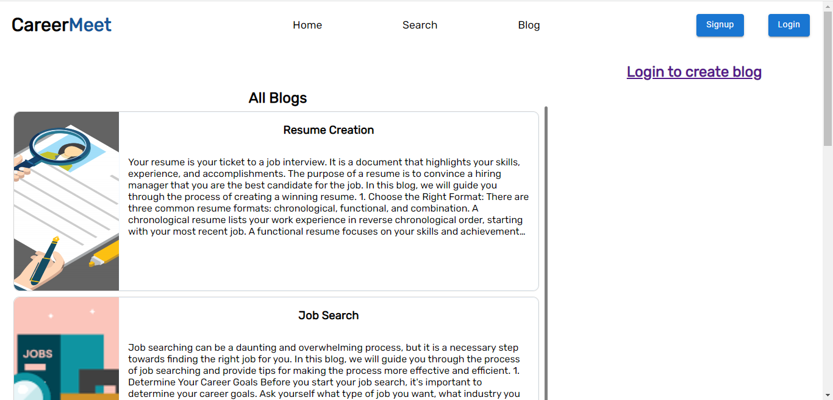
Blog

Slide 22
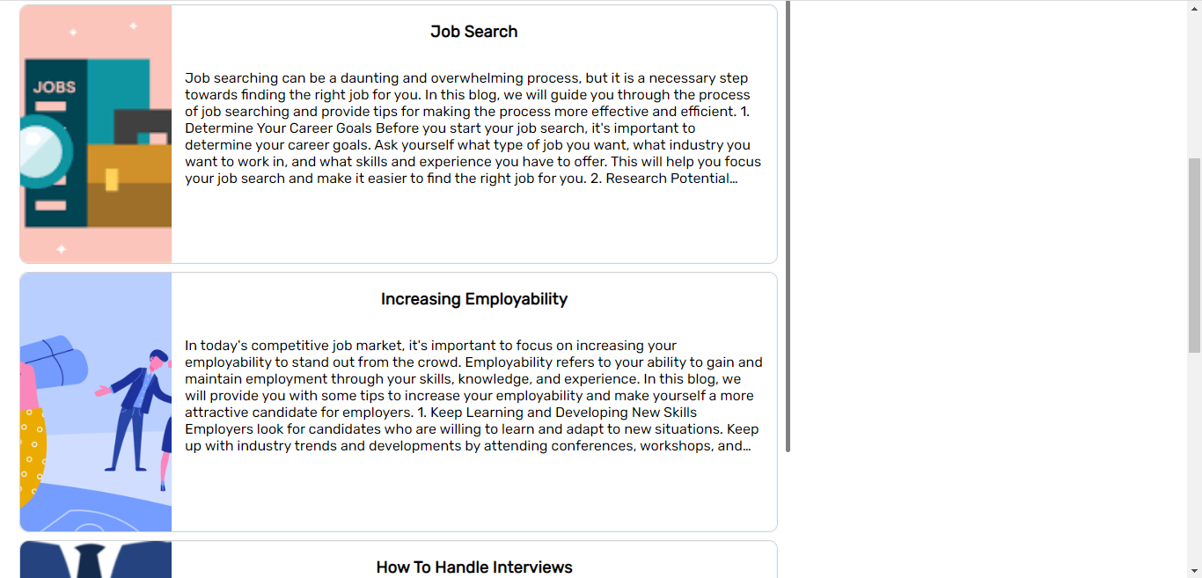

Slide 23
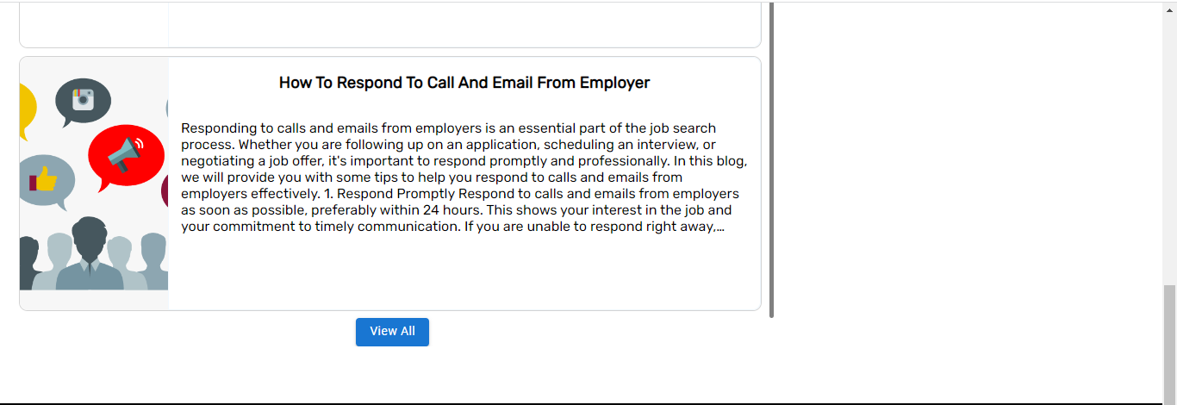

Slide 24
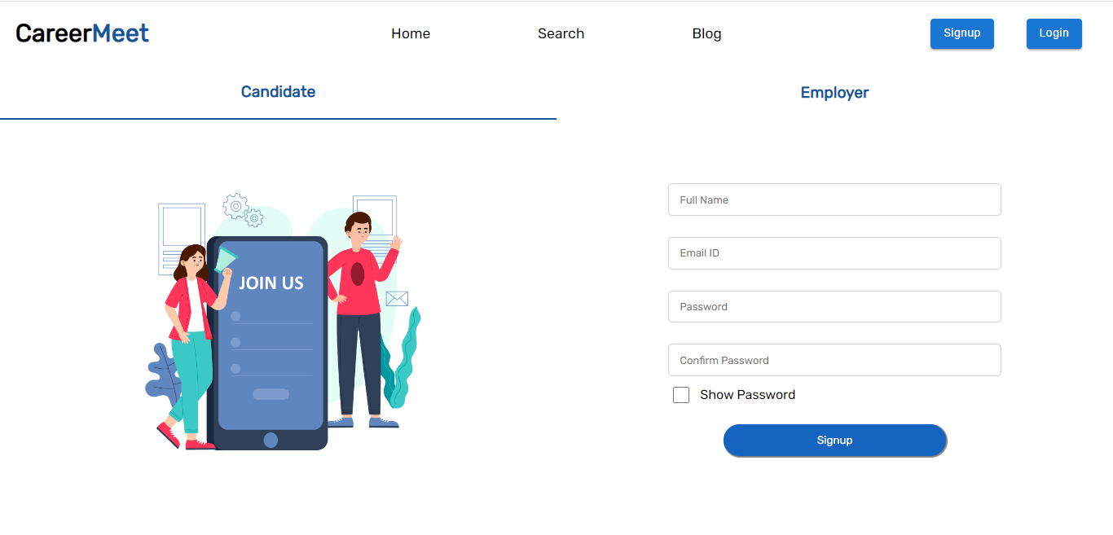
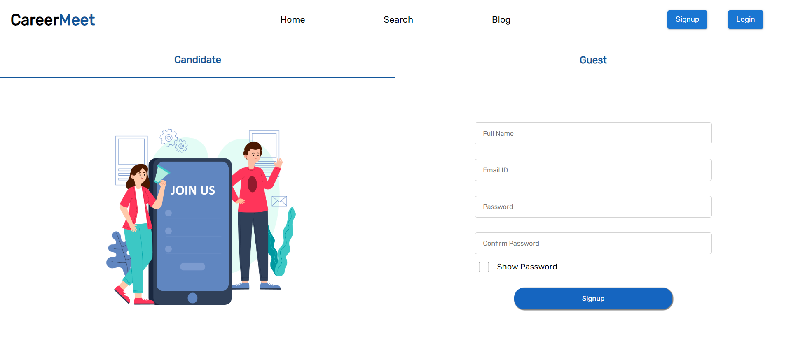
Signup(Candidate)

Slide 25
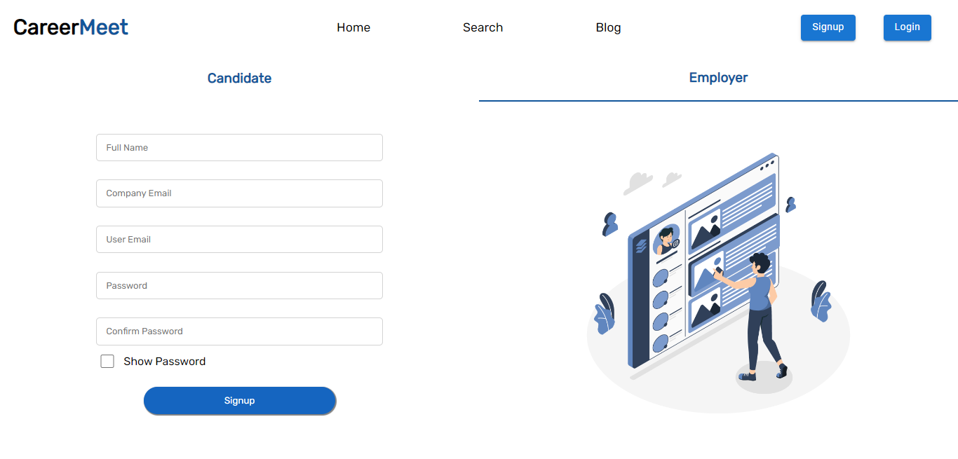
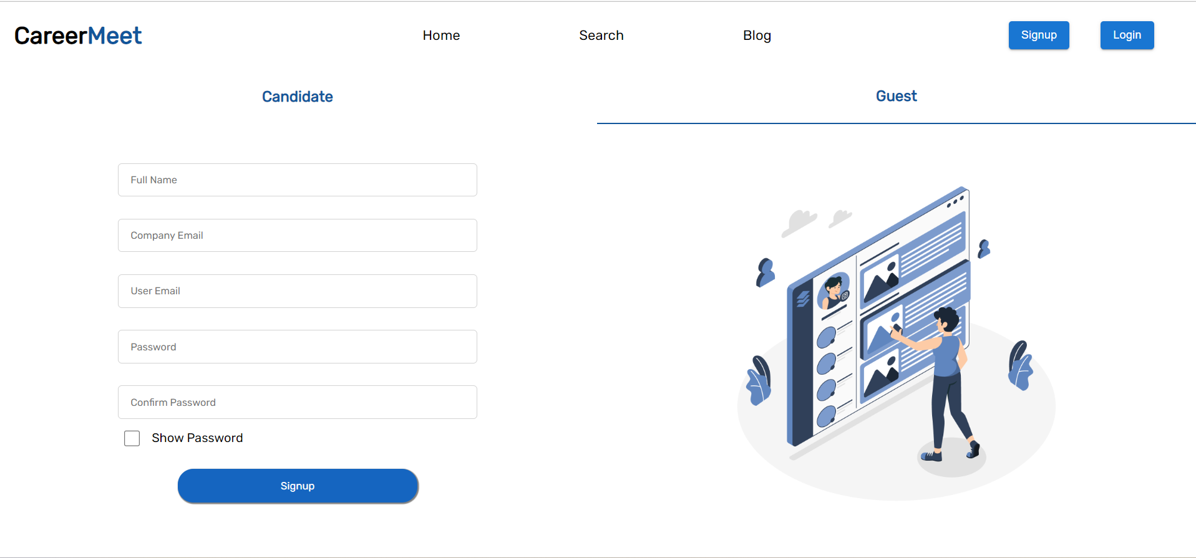
Signup(Employer)

Slide 26
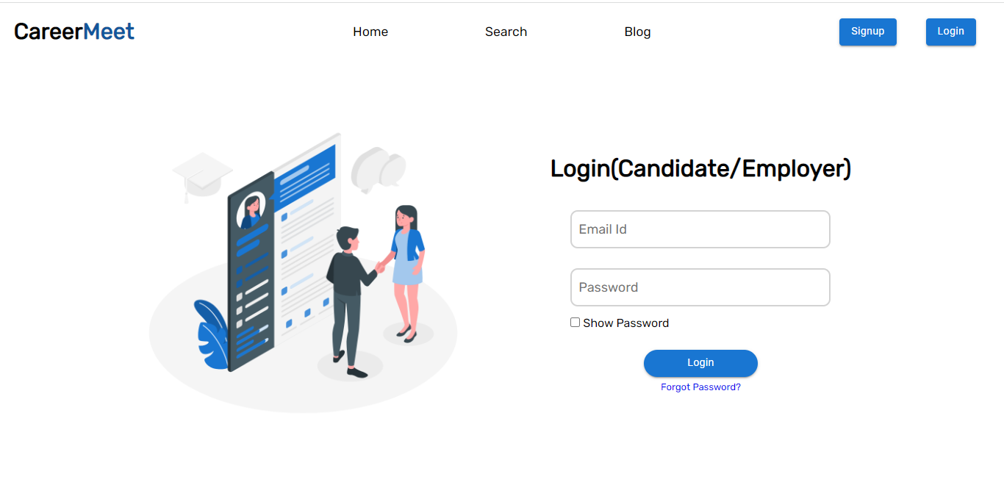
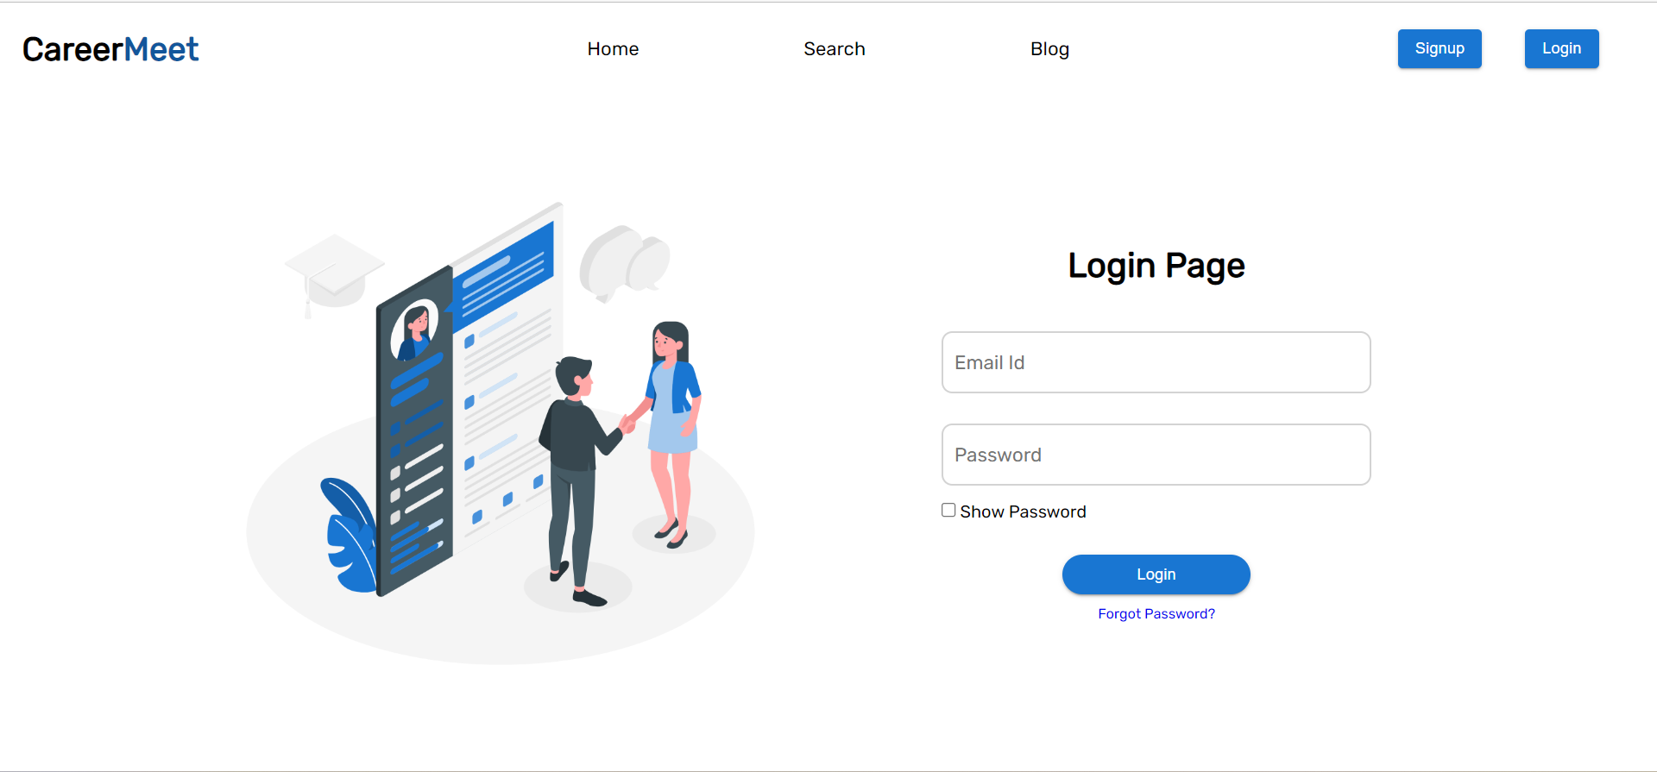
Login

Slide 27
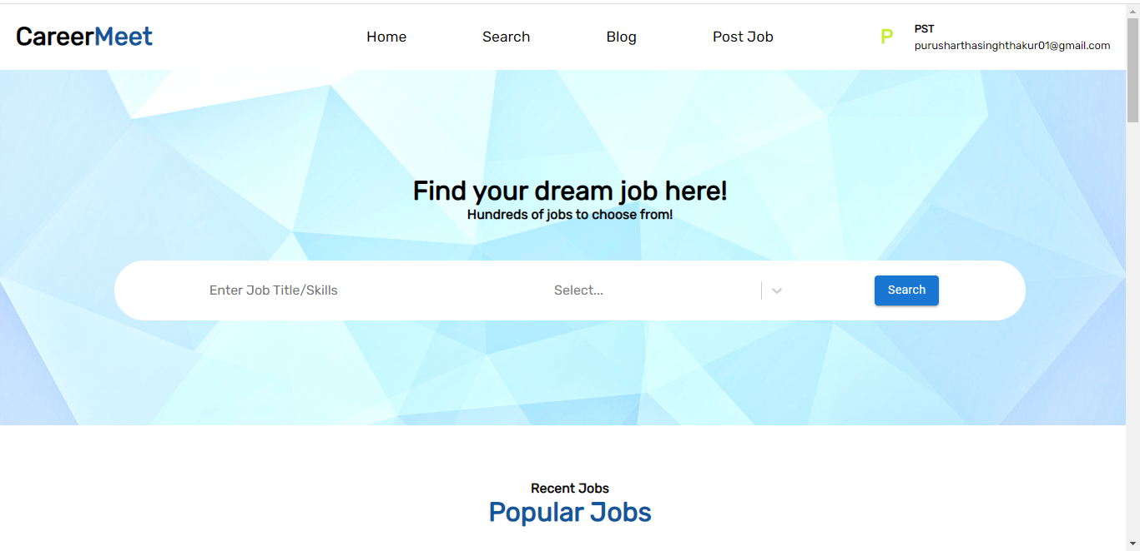
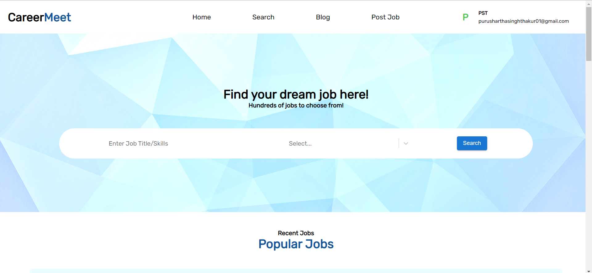
Home(After login)

Slide 28
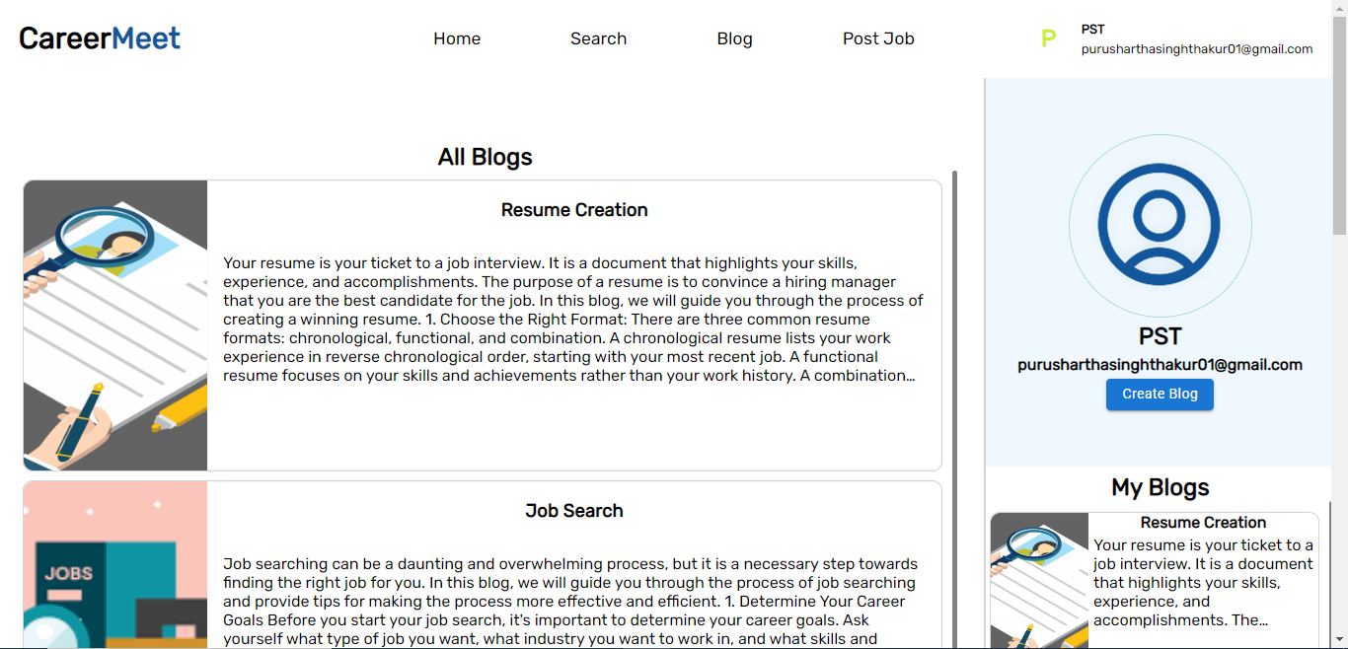
Blog(After login)

Slide 29
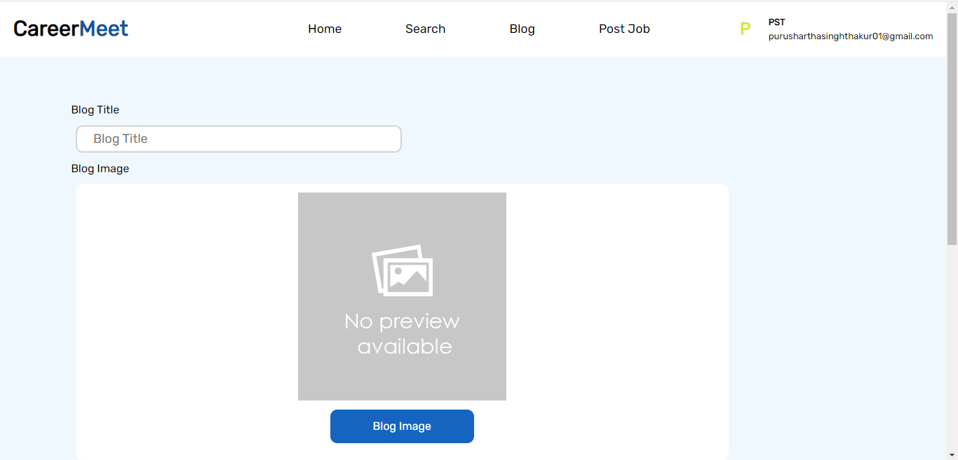
Create Blog

Slide 30
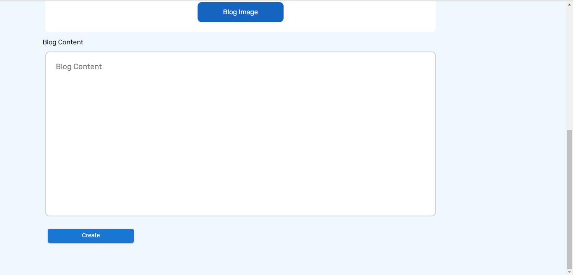

Slide 31
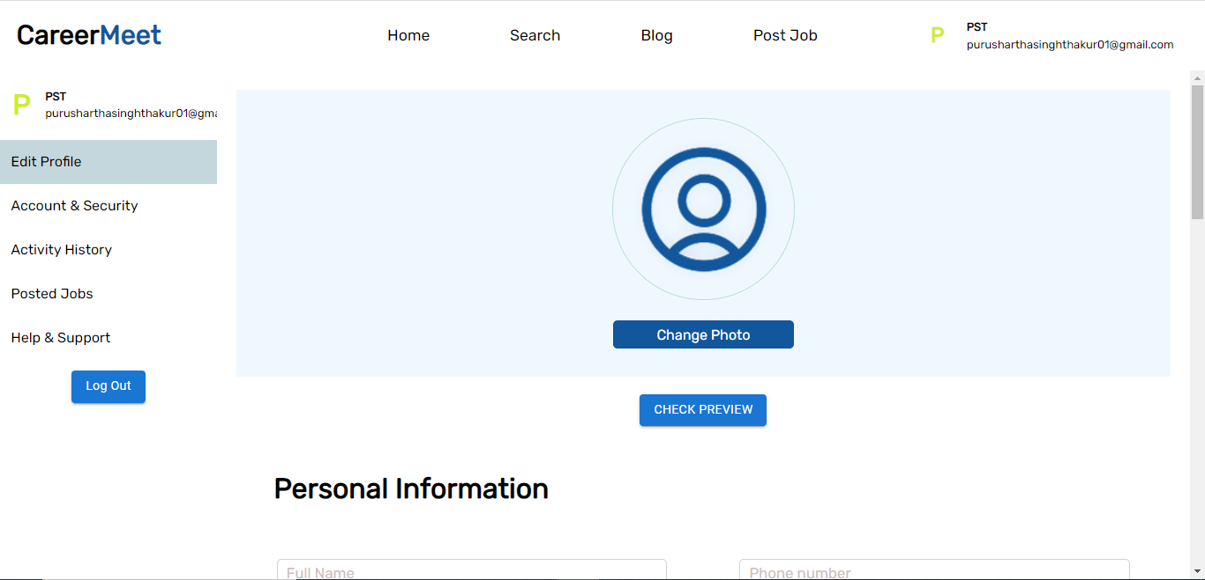
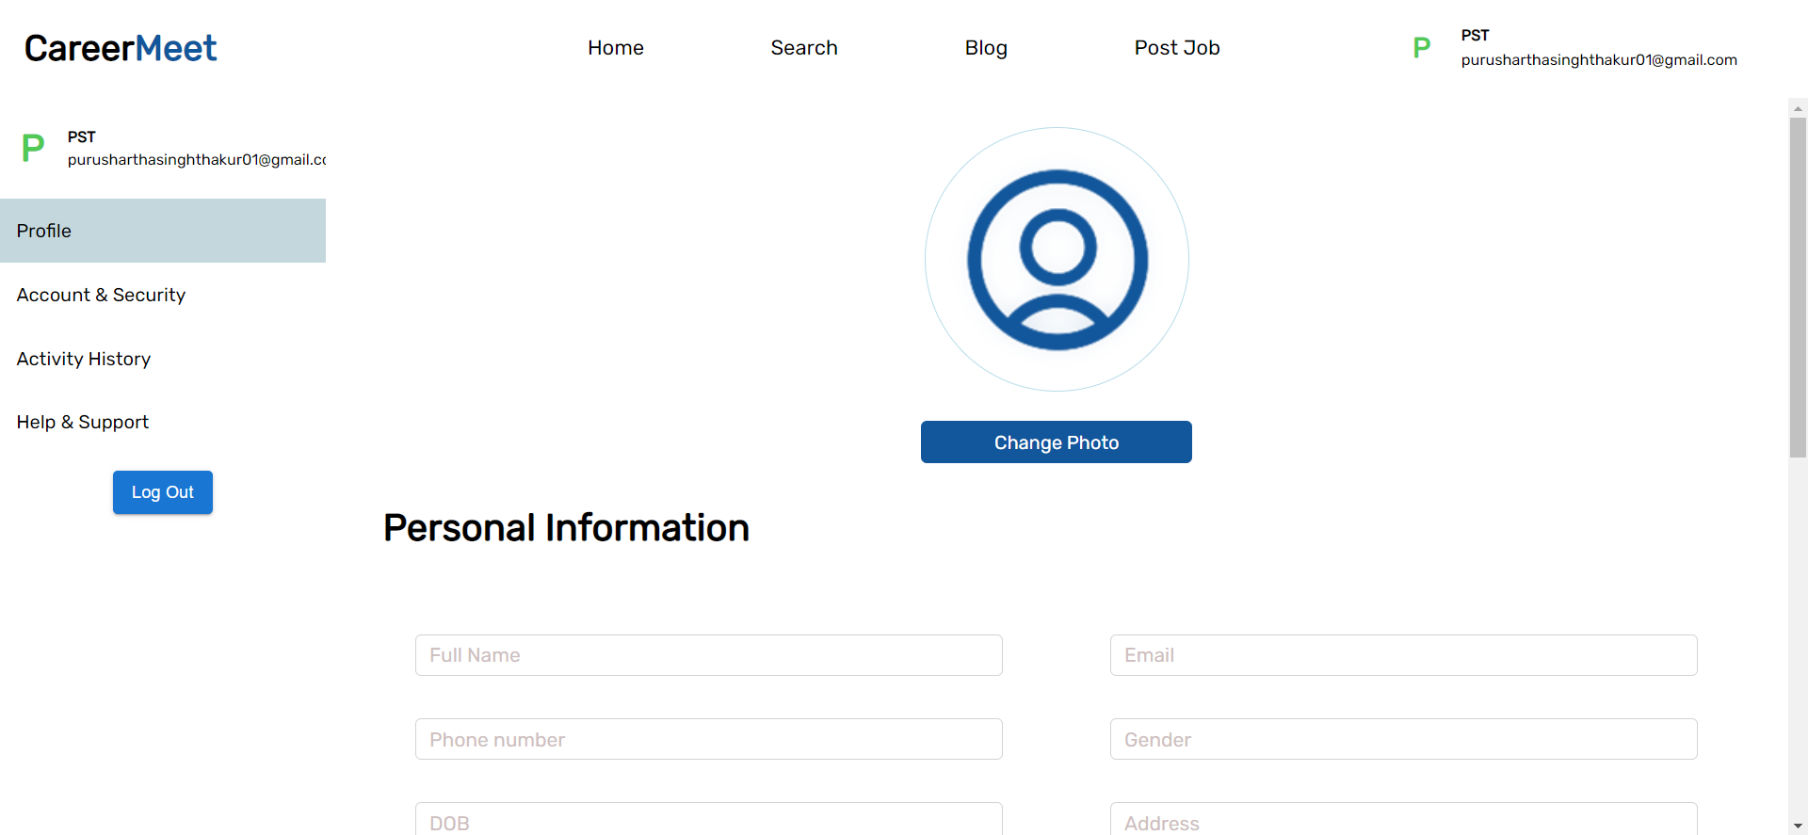
Profile

Slide 32
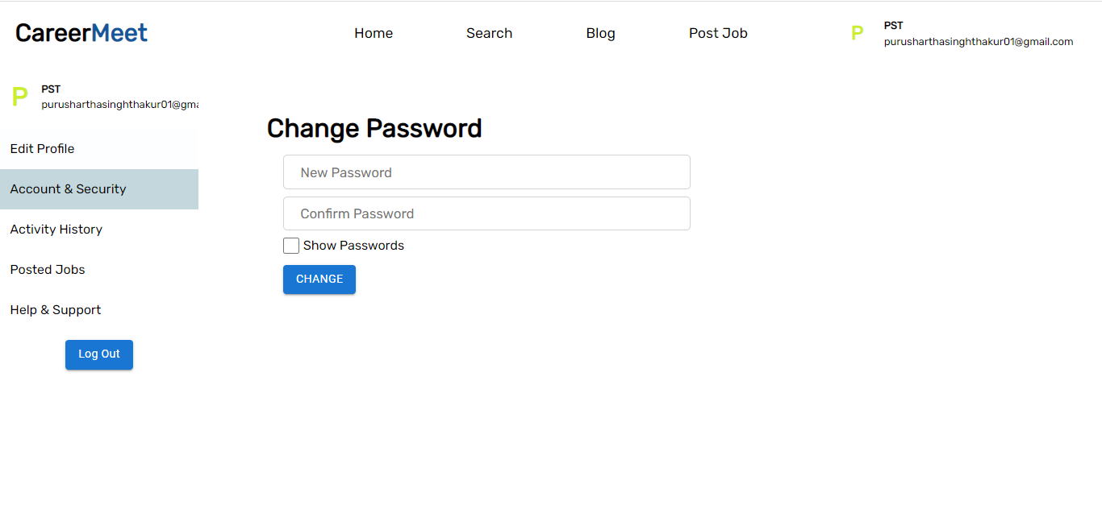

Slide 33
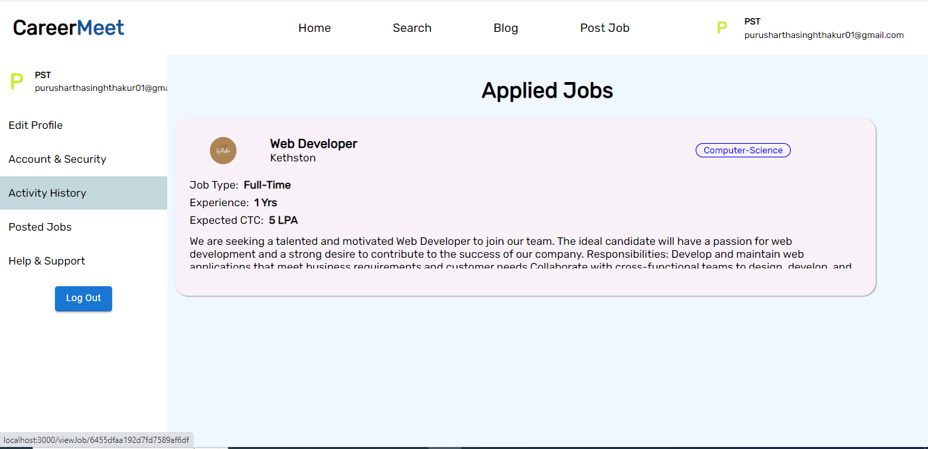

Slide 34
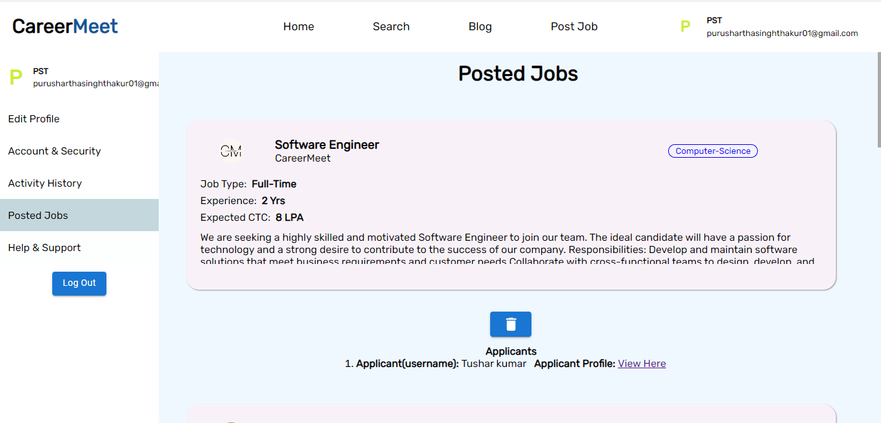

Slide 35
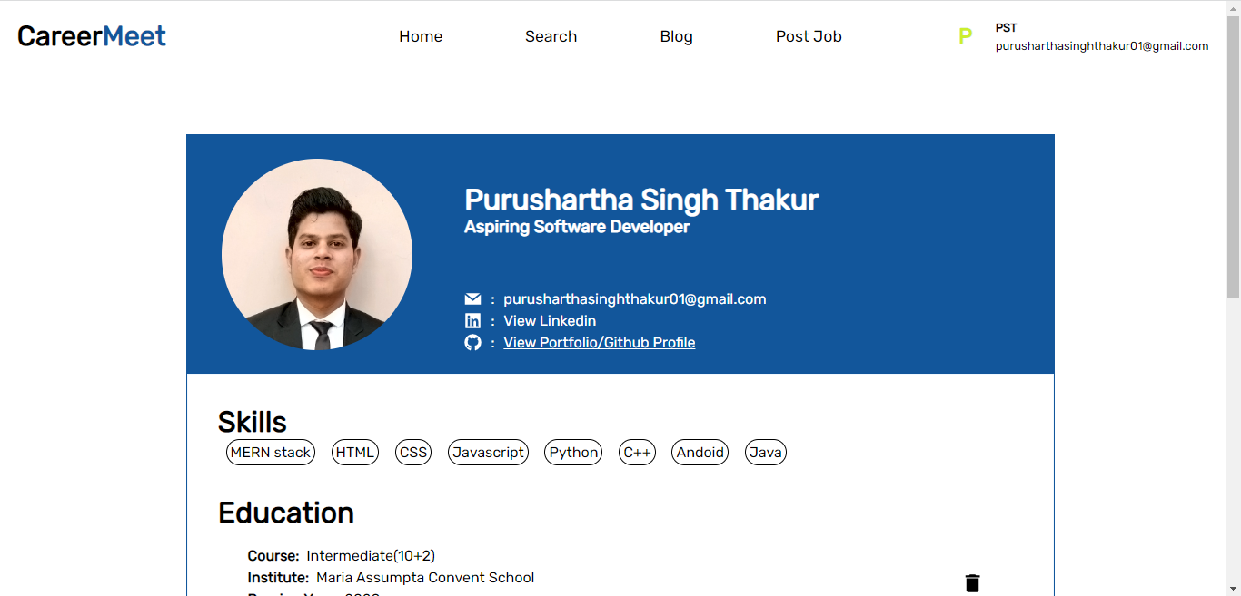
Profile Preview

Slide 36
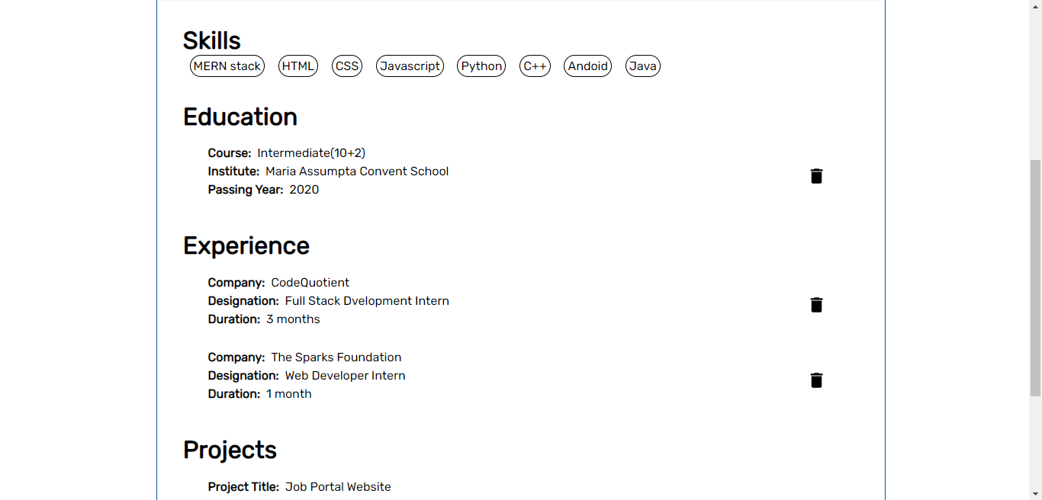

Slide 37
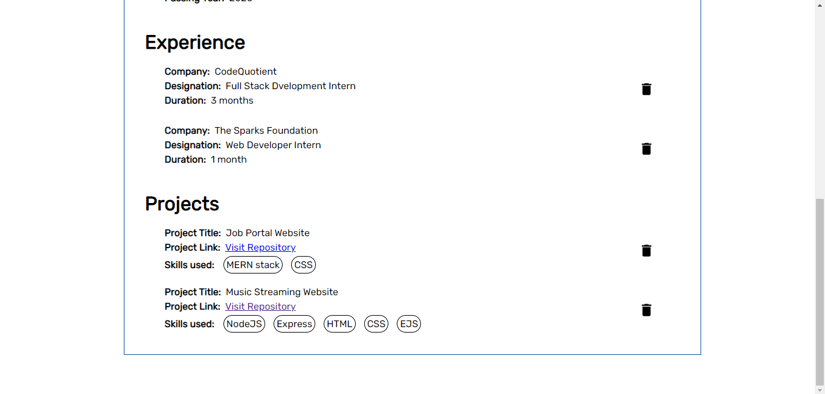

Slide 38
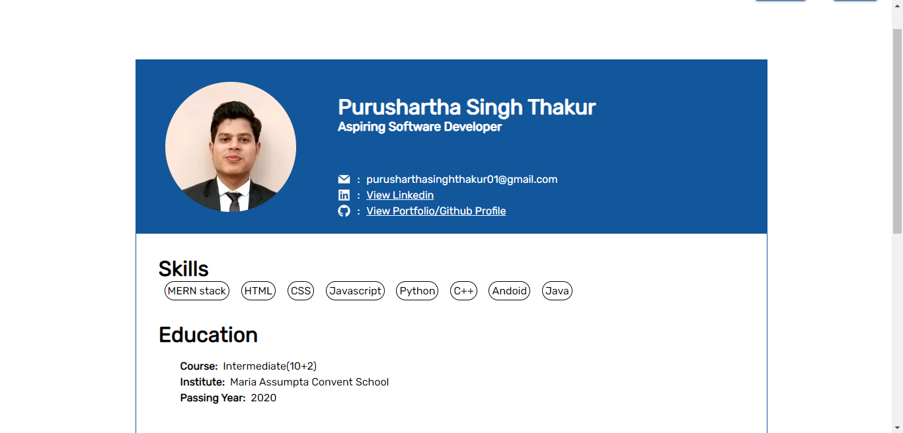
Profile

Slide 39
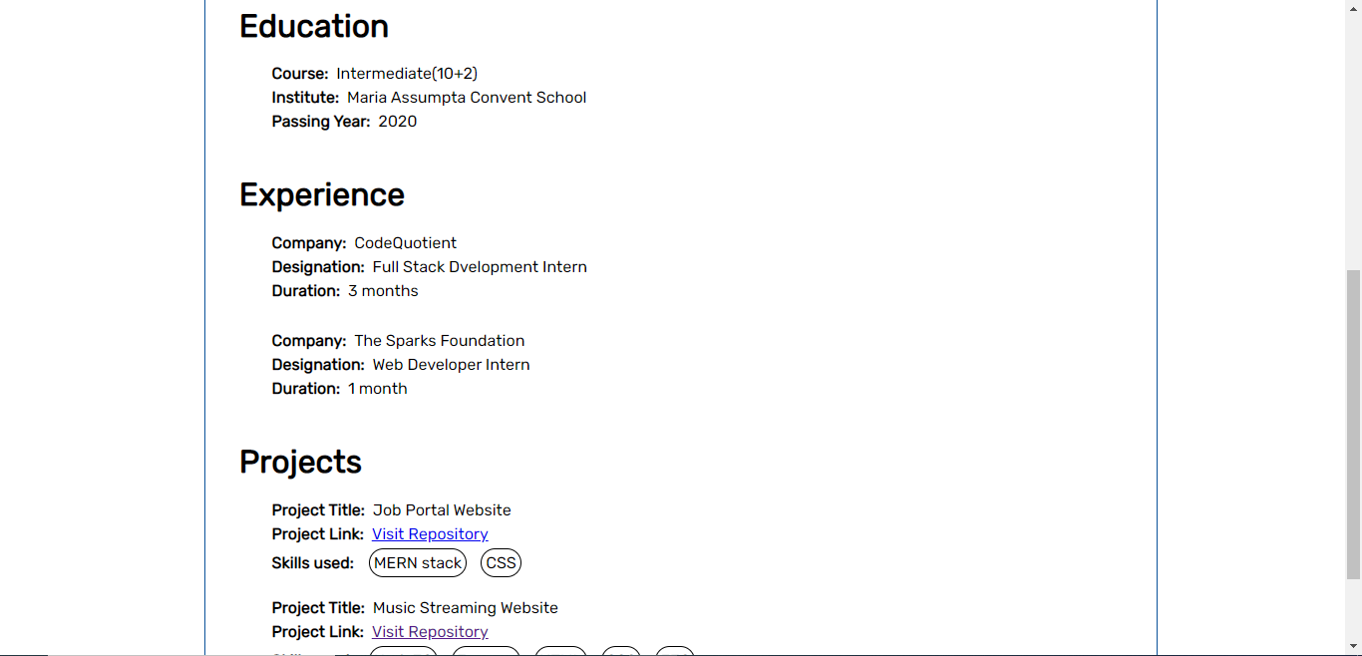

Slide 40
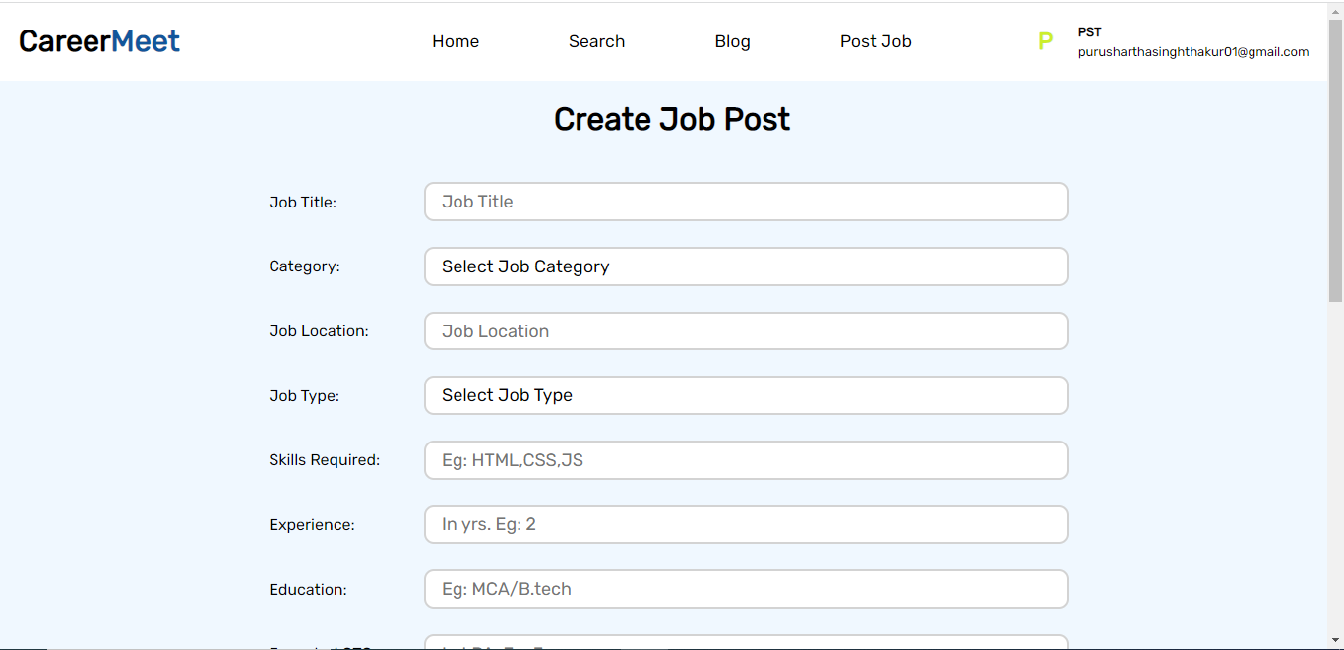
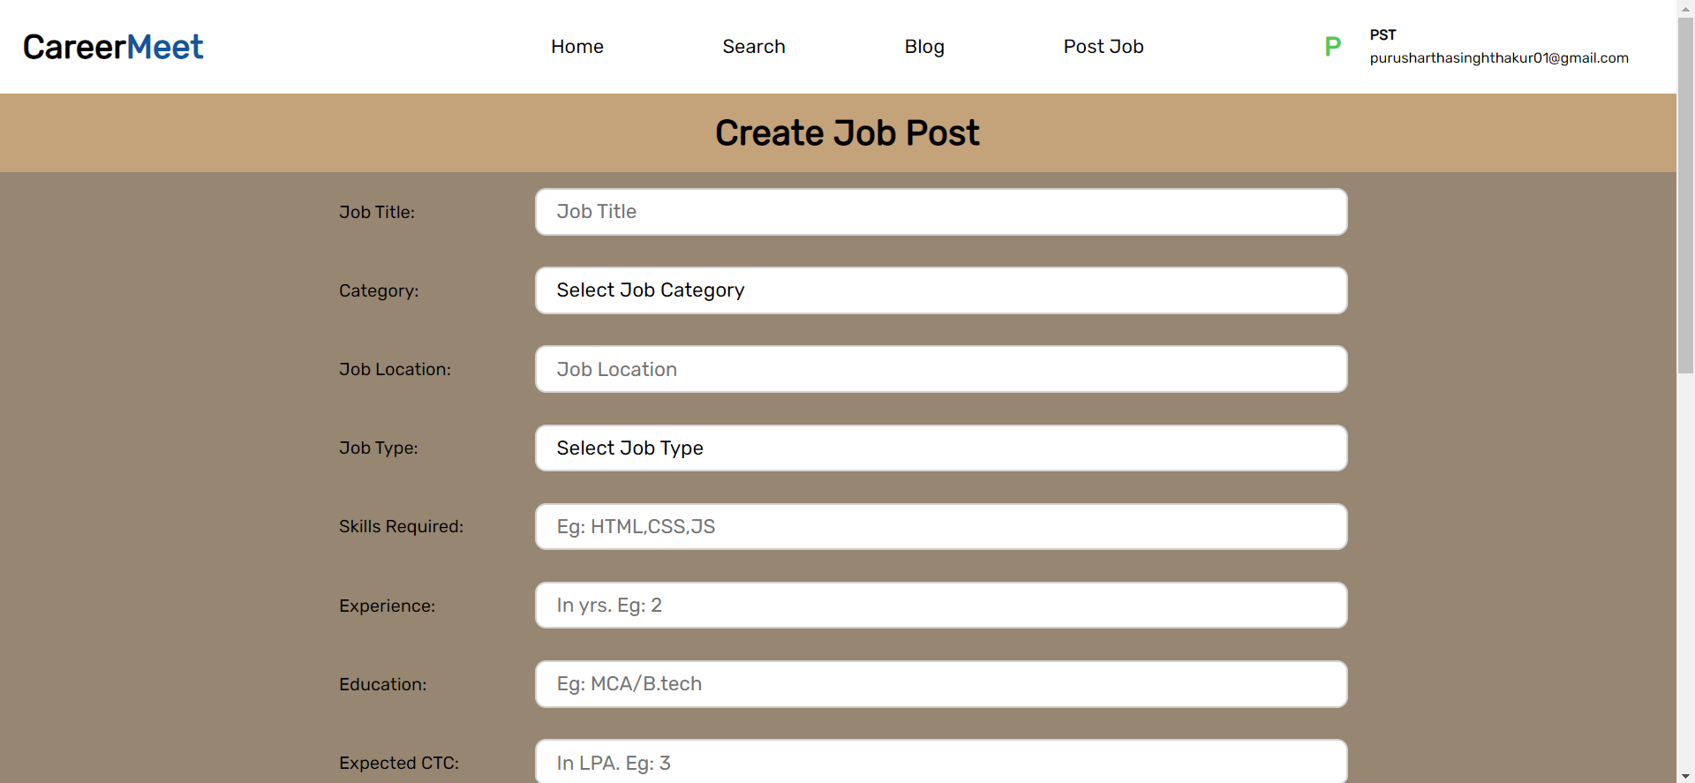
Create Job Post

Slide 41
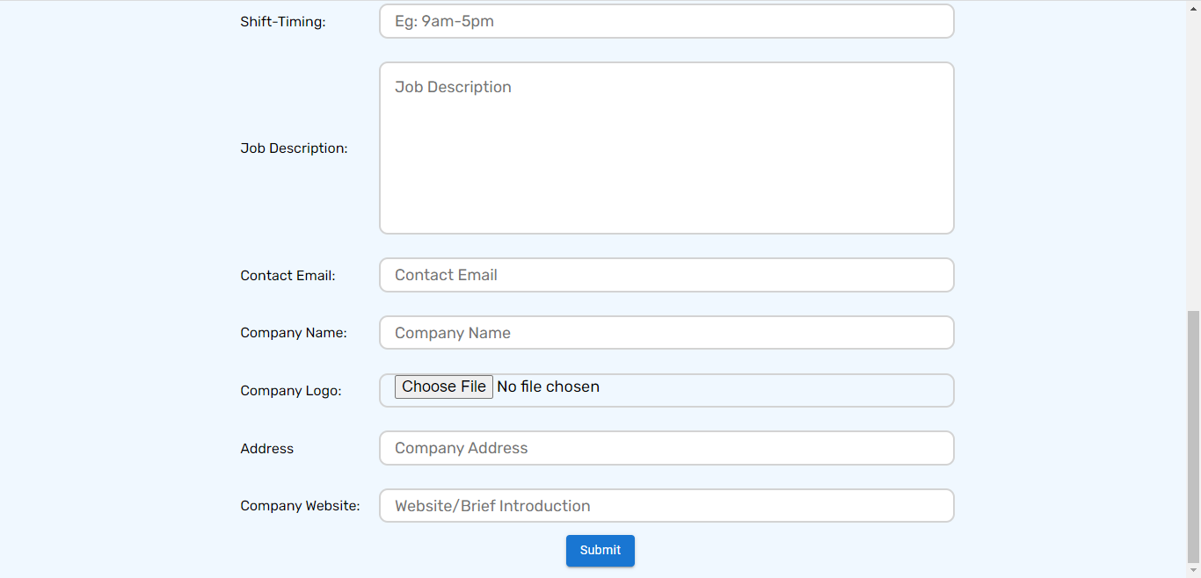

Slide 42
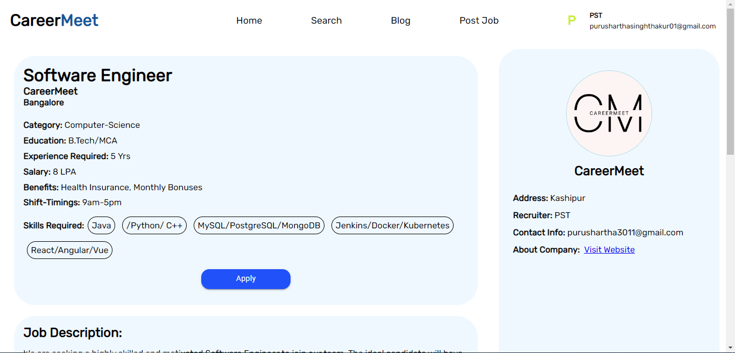
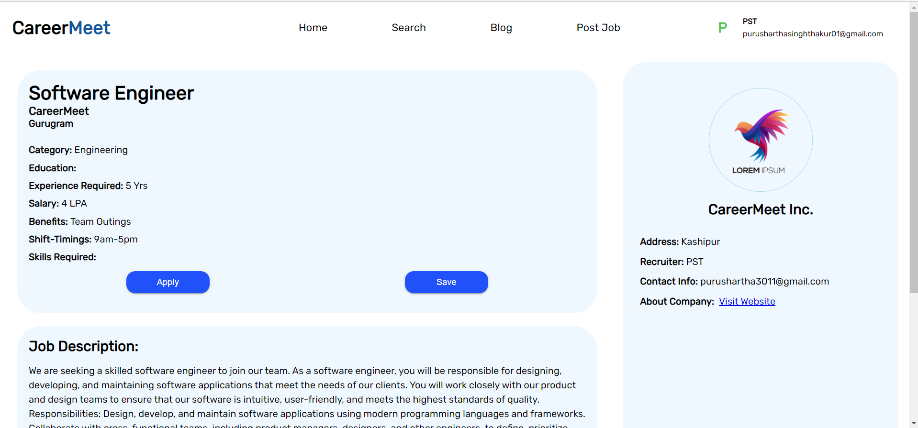
View Job Post

Slide 43
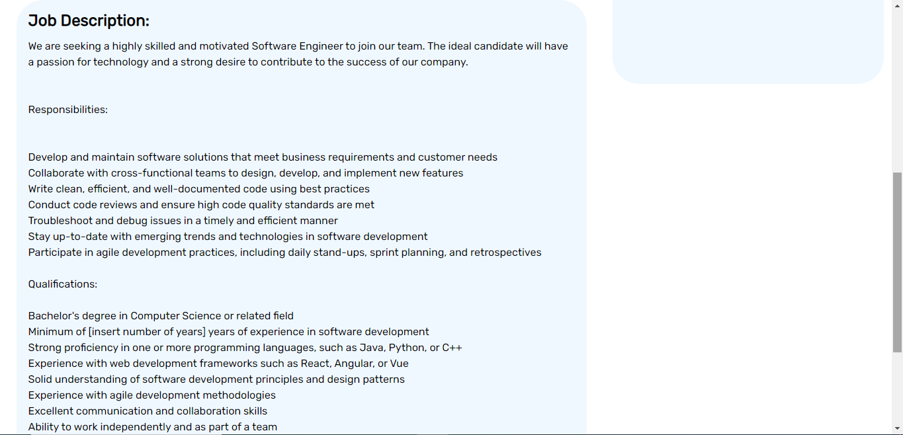

Slide 44
THANKS

